Slide 1
INSTRUCTION SET AND ASSEMBLY LANGUAGE PROGRAMMING OF 8086:
Unit-2

Slide 2
Addressing Modes
According to the flow of instruction execution ,instructions may be categorized as
1. Sequential Control flow instructions
2. Control transfer instructions
Sequential control flow instructions are the instructions which after execution transfer control to the next instruction appearing immediately. The control transfer instructions transfer control to some predefined address or the address somehow specified in the instruction after their execution.

Slide 3
Addressing Modes
Addressing Modes indicate a way of locating data or operands. The way in which the operand is given in the instruction is called the addressing mode . The addressing modes for sequential control flow instructions and control transfer instructions are as follows:

Slide 4
Addressing Modes

Slide 5
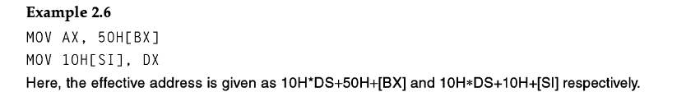
Addressing Modes

Slide 6
Addressing Modes

Slide 7
Addressing Modes

Slide 8
Addressing Modes

Slide 9
Addressing Modes

Slide 10
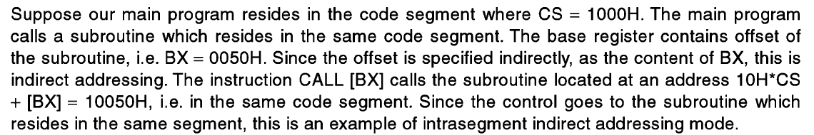
Example for Intra segment indirect addressing mode

Slide 11
Addressing Modes

Slide 12
Instruction Set
The Instruction set of 8086 microprocessor is classified into 8, they are:-
Data copy/transfer instructions
Arithmetic& logical instructions
Branch Instructions
Loop Instructions
Machine Control Instructions
Shift / rotate instructions
Flag manipulation instructions
String instructions

Slide 13
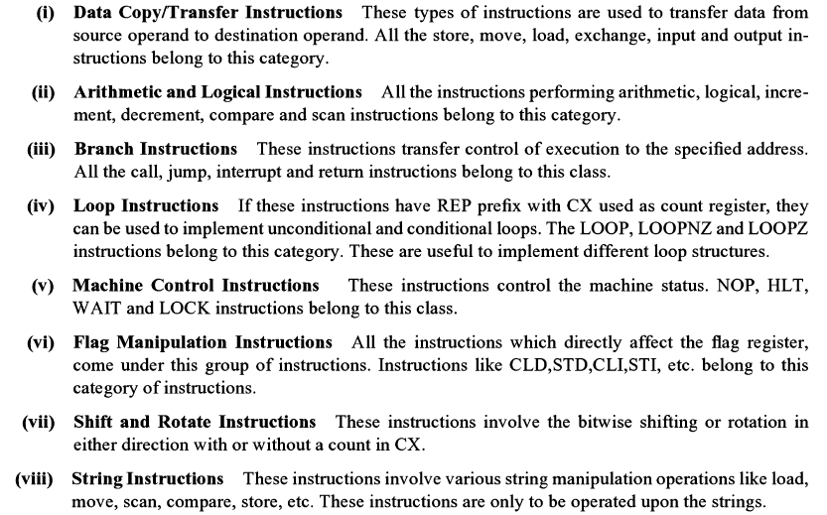

Slide 14
Data transfer instructions
These instructions are used to transfer the data from the source operand to the destination operand. Following are the list of instructions under this group
MOV− Used to copy the byte or word from the provided source to the provided destination. Eg1: Mov AX,5000H Eg2: MOV BX,CX
PUSH − Used to put a word at the top of the stack. The stack pointer is decremented by 2 after the execution of PUSH instruction. Eg : PUSH AX
POP − Used to get a word from the top of the stack to the provided location.
Note:PUSH and POP donot support immediate addressing mode.
The operand should be a 16-bit register.
Eg:PUSH BX
POP BX
PUSHA − Used to put all the registers into the stack.
XCHG− Used to exchange the data from two locations. Eg1:XCHG [5000H],AX Eg2:XCHG BX,AX
XLAT: This instruction is used for finding out the codes in case of code conversion problems.AL<-[BX+AL]

Slide 15
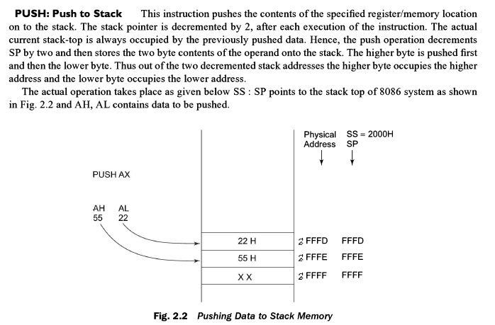

Slide 16
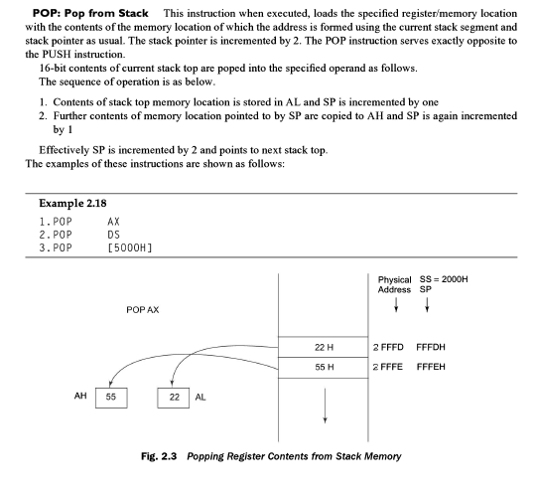

Slide 17
Data transfer instructions
INSTRUCTIONS FOR I/O TRANSFER
IN − Used to read a byte or word from the provided INPUT device(Port Address) to the accumulator.
OUT − Used to send out a byte or word from the accumulator to the provided O/P device(Port Address).
I/O addresses can range from 0000h to FFFFh
Example:
IN AL, 0F8H ; Copy a byte from the port address 0F8H to AL
MOV DX, 30F8H ; Copy port address in DX
IN AL, DX ; Move 8 bit data from 30F8H port
IN AX, DX ; Move 16 bit data from 30F8H port
OUT 47H, AL ; Copy contents of AL to 8 bit port 47H
Note: For 8-bit I/O address, we use direct addressing mode, where as if the I/O address is a 16-bit address we use indirect addressing mode using DX register.

Slide 18
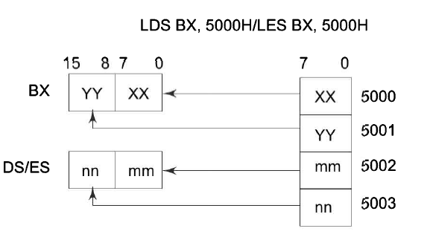
Data transfer instructions
INSTRUCTIONS TO TRANSFER THE ADDRESS
LEA − Used to load the address of operand into the provided register.
Ex: LEA BX , ADDR
LDS/Load pointer to DS − Used to load DS register and other provided register from the memory.
LES/ Load pointer to ES − Used to load ES register and other provided register from the memory.
Ex: LDS BX,5000H
INSTRUCTIONS TO OPERATE ON FLAGS
LAHF − Used to load AH with the low byte of the flag register. AH<-FL(lower byte)
SAHF − Used to store AH register to low byte of the flag register. AH->FL(lower byte)
PUSHF − Used to copy the flag register at the top of the stack.
POPF − Used to copy a word at the top of the stack to the flag register.

Slide 19
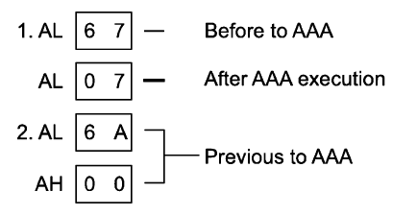
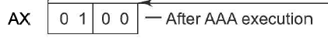
ARITHMETIC INSTRUCTIONS
These instructions are used to perform arithmetic operations like addition, subtraction, multiplication, division, etc.
INSTRUCTIONS TO PERFORM ADDITION
ADD − Used to add the provided byte to byte/word to word.
ADC − Used to add with carry.
AAA(ASCII ADJUST AFTER ADDITION) − Used to adjust to ASCII after addition.
This instruction is executed after an add instruction that adds two ASCII codes
Whose result is store in AL.

Slide 20
ARITHMETIC INSTRUCTIONS
DAA(Decimal Adjust after Addition) − Used to adjust the decimal after the addition/subtraction operation. Its an 8-bit instruction. It works on AL register.
This instruction is used after adding two numbers.
Eg: 25H+25H=4A=4A+06 =50
If the lower nibble of the result is greater THAN 9 or an Auxilliary carry is produced add 06h else of the higher nibble is greater than 9 or carry is produced , add 60 to the result else if both lower and higher nibbles are greater then 9, then add 66h to the result.

Slide 21
ARITHMETIC INSTRUCTIONS
INSTRUCTIONS TO PERFORM SUBTRACTION
SUB − Used to subtract the byte from byte/word from word.
Eg: SUB BL,CL
BL<-BL-CL
SBB − Used to perform subtraction with borrow.
Eg: SBB BL,CL
BL<-BL-CL-CF
NEG − Used to negate each bit of the provided byte/word and add 1 (2’s complement).
Eg: NEG BL

Slide 22
ARITHMETIC INSTRUCTIONS
AAS(ASCII ADJUST AL AFTER SUBTRACTION) − Used to adjust ASCII codes after subtraction.
The resulting number will be in unpacked Decimal FORMAT.
Algorithm:
If low nibble of AL > 9 or AF = 1 then: AL=AL-6, AH=AH-1, AF=1, CF=1
else : AF=0, CF=0
In both the cases Clear the Higher Nibble of AL.

Slide 23
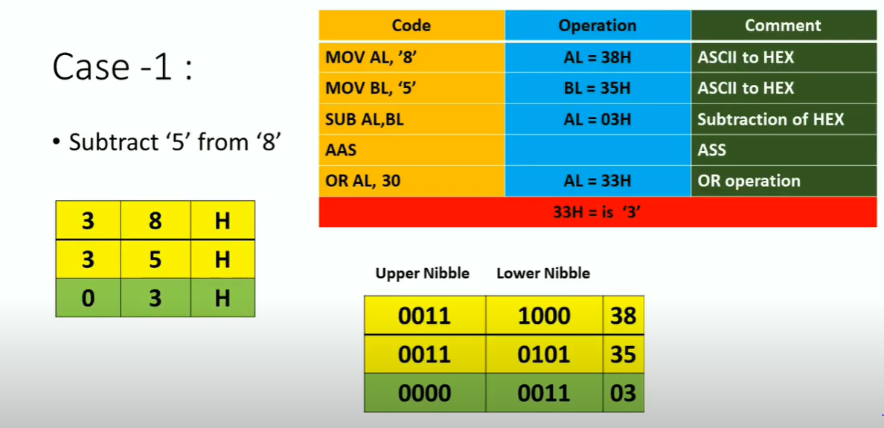
Example for AAS

Slide 24
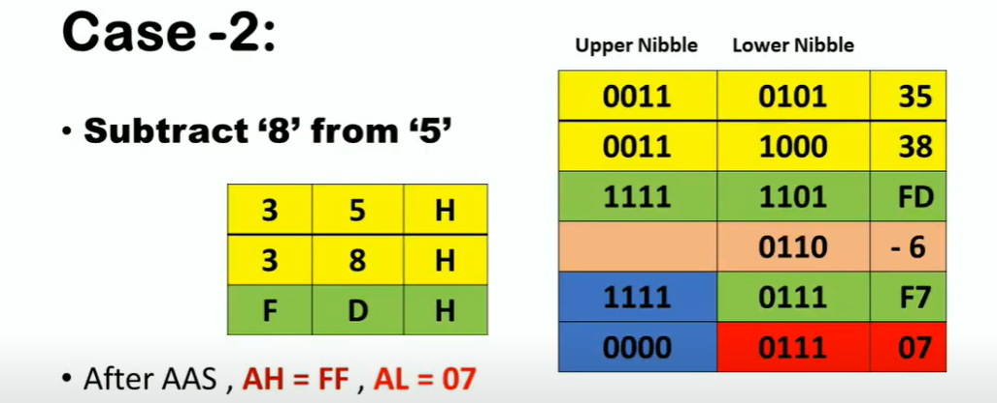
Example for AAS

Slide 25
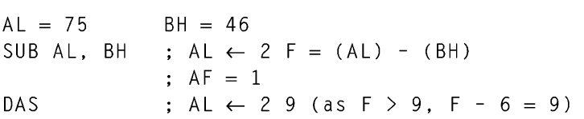
ARITHMETIC INSTRUCTIONS
DAS − Used to adjust to decimal after subtraction. Same as DAA ,but instead of adding 6,we subtract 6 from the lower or higher nibble.

Slide 26
ARITHMETIC INSTRUCTIONS
CMP: COMPARE
The instruction compares the source operand, which may be a register or an immediate data or a memory location, with a destination operand that may be a register or a memory location.
For comparison, it subtracts the source operand from the destination operand but does not store the result anywhere. (Destination operand-Source operand)
EX: CMP AX,BX
CMP AL,25H
The flags are affected depending upon the result of the subtraction.
If both of the operands are equal, zero flag is set.
If the source operand is greater than the destination operand, carry flag is set or else, carry flag is reset.
INC & DEC instructions
INC and DEC instructions are used to increment and decrement the content of the specified destination by one.
Example:
INC AL ; AL<= AL + 1
INC AX ; AX<=AX + 1
DEC AL ; AL<= AL – 1
DEC AX ; AX<=AX – 1

Slide 27
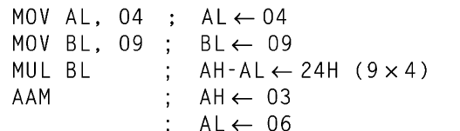
ARITHMETIC INSTRUCTIONS
INSTRUCTION TO PERFORM MULTIPLICATION
MUL − Used to multiply unsigned byte by byte/word by word.
Eg: MUL BH
AX= AL * BH
Eg: MUL BX
DX,AX= AX * BX
IMUL − Used to multiply signed byte by byte/word by word.(I stands for Integer)
AAM − Used to adjust ASCII codes after multiplication. Converts the product available in AL to unpacked BCD format.

Slide 28
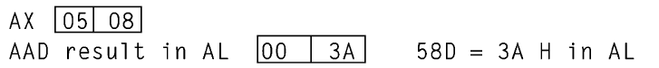
ARITHMETIC INSTRUCTIONS
INSTRUCTIONS TO PERFORM DIVISION
DIV − Used to divide the unsigned word by byte or unsigned double word by word.We divide a 16-bit number by 8-bit number or 32-bit number by 16-bit number.
Eg: DIV BL (Here BL is divisor and Accumulator is Dividend) AH, AL <-AX/BL AL<-Quotient, AH <- Remainder
Similarly DIV BX ; DX,AX= DX AX/BX AX<-Quotient, DX<-Remainder
IDIV − Used to divide the signed word by byte or signed double word by word.
AAD(ASCII ADJUST BEFORE DIVISION) − Used to adjust ASCII codes BEFORE division.
Now divide 3A BY 07H TO GET QUOTIENT AS 8 and remainder as 2.
Note: For complex arithmetic, the second operand is always an accumulator.
8-bit accumulator is always AL
16-bit accumulator is AX
32 bit accumulator is DX,AX

Slide 29
Other Instructions
CBW: Convert Byte to word
Works on AL REGISTER AX<-AL
Should be only used for negative numbers.
CWD :Convert word to Double word
DX,AX<-AX

Slide 30
LOGICAL INSTRUCTIONS
These instructions are used to perform operations where data bits are involved, i.e. operations like logical, shift, etc.
INSTRUCTIONS TO PERFORM LOGICAL OPERATION
NOT − Used to invert each bit of a byte or word.
Eg:NOT BL
AND − Used for adding each bit in a byte/word with the corresponding bit in another byte/word.
Eg:AND BL,CL
OR − Used to multiply each bit in a byte/word with the corresponding bit in another byte/word.
Eg:OR BL,CL
XOR − Used to perform Exclusive-OR operation over each bit in a byte/word with the corresponding bit in another byte/word.
Eg:XOR BL,CL
TEST − Used to AND operands to update flags, without affecting operands.

Slide 31
INSTRUCTIONS TO PERFORM SHIFT OPERATIONS
Syntax: Instruction Reg, Count
If the count is anything other than 1,Give the count using CL register . If it is 1 ,it can be directly given in the instruction.
INSTRUCTIONS TO PERFORM SHIFT OPERATIONS
SHL/SAL −Used to shift bits of a byte/word towards left and put zero(S) in LSBs.
Eg: SHL BL,1
SHR −Used to shift bits of a byte/word towards the right and put zero(S) in MSBs.
Eg: SHR BL,1
SAR −Used to shift bits of a byte/word towards the right and copy the old MSB into the new MSB.
Eg: SAR BL,1
INSTRUCTIONS TO PERFORM ROTATE OPERATIONS
ROL − Used to rotate bits of byte/word towards the left, i.e. MSB to LSB and to Carry Flag [CF].
Eg: ROL BL,1
ROR − Used to rotate bits of byte/word towards the right, i.e. LSB to MSB and to Carry Flag [CF].
Eg: ROR BL,1
RCR − Used to rotate bits of byte/word towards the right, i.e. LSB to CF and CF to MSB. Eg:RCR BL,1
RCL − Used to rotate bits of byte/word towards the left, i.e. MSB to CF and CF to LSB. Eg:RCL BL,1

Slide 32
INSTRUCTIONS TO PERFORM SHIFT OPERATIONS
Syntax: Instruction Reg, Count
If the count is anything other than 1,Give the count using CL register . If it is 1 ,it can be directly given in the instruction.
INSTRUCTIONS TO PERFORM SHIFT OPERATIONS
SHL/SAL −Used to shift bits of a byte/word towards left and put zero(S) in LSBs.
Eg: SHL BL,1
SHR −Used to shift bits of a byte/word towards the right and put zero(S) in MSBs.
Eg: SHR BL,1
SAR −Used to shift bits of a byte/word towards the right and copy the old MSB into the new MSB.
Eg: SAR BL,1
INSTRUCTIONS TO PERFORM ROTATE OPERATIONS
ROL − Used to rotate bits of byte/word towards the left, i.e. MSB to LSB and to Carry Flag [CF].
Eg: ROL BL,1
ROR − Used to rotate bits of byte/word towards the right, i.e. LSB to MSB and to Carry Flag [CF].
Eg: ROR BL,1
RCR − Used to rotate bits of byte/word towards the right, i.e. LSB to CF and CF to MSB. Eg:RCR BL,1
RCL − Used to rotate bits of byte/word towards the left, i.e. MSB to CF and CF to LSB. Eg:RCL BL,1

Slide 33
STRING INSTRUCTIONS
String is a group of bytes/words and their memory is always allocated in a sequential order. For referring a string we require a) starting address/ending address and b)length of the string.
Length of the string is usually stored as count in register CX.
REP instruction prefix − Used to repeat the given instruction till CX becomes 0.At each iteration CX is automatically decremented by 1.
REPE/REPZ(Repeat on equal) − Used to repeat the given instruction while zero flag ZF = 1 or till CX=0.(Used for comparing strings)
REPNE/REPNZ(Repeat on not equal) − Used to repeat the given instruction while zero flag ZF = 0 or till CX=0.(used along with SCAS instruction to scan a string)
MOVS/MOVSB/MOVSW − Used to move the byte/word from DS to ES. The count must be always stored in CX Register . Clear or set the Direction flag using CLD/STD.
MOVSB: DS:[SI]-> ES:[DI]
SI=SI+/-1
DI=DI+/-1;

Slide 34
Example of MOVS INSTRUCTION

Slide 35
STRING INSTRUCTIONS
CMPS/CMPSB/CMPSW − Used to compare two string bytes/words at the source and destination segments DS and ES pointed by SI and DI .Length of the string must be stored in CX Register.
If two strings are equal the ZF will be equal to 1.
SCAS/SCASB/SCASW − Used to scan a string and compare its byte with a byte in AL or string word with a word in AX. The string is pointed to by the ES:[DI] REGISTER PAIR.
Compares ES:[DI] with AL. Check the zero flag. If match found zero flag will be 1 else it will be zero.
Whenever zero flag is set o one execution stops
LODS/LODSB/LODSW − Used to store the string byte into AL or string word into AX
LODSB: AL<-DS:[SI]
SI<-SI +/- 1
LODSW: AX<-DS:[SI],DS:[SI+1]
SI<-SI +/- 2
STOS/STOSB/STOSW: Used to store the AL/AX register contents to a location pointed by ES:[DI]

Slide 36
PROGRAM TRANSFER INSTRUCTIONS (BRANCH AND LOOP INSTRUCTIONS)
These instructions are used to transfer/branch the instructions during an execution. It includes the following instructions −
There are 2 types of such instructions. They are:
1. Unconditional transfer instructions – CALL, RET, JMP
2. Conditional transfer instructions – J condition
Unconditional transfer instructions
Instructions to transfer the instruction during an execution without any condition −
CALL − Used to call a procedure and save their return address to the stack.
RET − Used to return from the procedure to the main program.
JMP − Used to jump to the provided address to proceed to the next instruction.
INT N-

Slide 37
PROGRAM TRANSFER INSTRUCTIONS (BRANCH AND LOOP INSTRUCTIONS)

Slide 38
PROGRAM TRANSFER INSTRUCTIONS (BRANCH AND LOOP INSTRUCTIONS)
Conditional Transfer instructions
Instructions to transfer the instruction during an execution with some conditions −
JA/JNBE − Used to jump if above/not below/equal instruction satisfies i.e CF=0 and ZF=0.
JAE/JNB − Used to jump if above/not below instruction satisfies i.e CF=0 / ZF=1.
JBE/JNA − Used to jump if below/equal/ not above instruction satisfies i.e CF=1 / ZF=1.
JC − Used to jump if carry flag CF = 1
JE/JZ − Used to jump if equal/zero flag ZF = 1
JG/JNLE − Used to jump if greater/not less than/equal instruction satisfies. i.e ZF=0 and SF=OF
JGE/JNL − Used to jump if greater than/equal/not less than instruction satisfies. i.e ZF=1 or SF=OF.

Slide 39
PROGRAM TRANSFER INSTRUCTIONS (BRANCH AND LOOP INSTRUCTIONS)
Conditional Transfer instructions
JL/JNGE − Used to jump if less than/not greater than/equal instruction satisfies. i.e SF≠OF
JLE/JNG − Used to jump if less than/equal/if not greater than instruction satisfies. SF≠OF and ZF=1.
JNC − Used to jump if no carry flag (CF = 0)
JNE/JNZ − Used to jump if not equal/zero flag ZF = 0
JNO − Used to jump if no overflow flag OF = 0
JNP/JPO − Used to jump if not parity/parity odd PF = 0
JNS − Used to jump if not sign SF = 0
JO− Used to jump if overflow flag OF = 1
JP/JPE− Used to jump if parity/parity even PF = 1
JS− Used to jump if sign flag SF = 1

Slide 40
PROGRAM TRANSFER INSTRUCTIONS (BRANCH AND LOOP INSTRUCTIONS)
LOOPE/LOOPZ − Used to loop a group of instructions while ZF = 1 / CX = 0
LOOPNE/LOOPNZ − Used to loop a group of instructions while ZF = 0 / CX = 0
JCXZ − Used to jump to the provided address if CX = 0

Slide 41
FLAG MANIPULATION INSTRUCTIONS
These instructions are used to control the processor action by setting/resetting the flag values.
STC − Used to set carry flag CF to 1
CLC − Used to clear/reset carry flag CF to 0
CMC − Used to put complement at the state of carry flag CF.
STD − Used to set the direction flag DF to 1
CLD − Used to clear/reset the direction flag DF to 0
STI − Used to set the interrupt enable flag to 1, i.e., enable INTR input.
CLI − Used to clear the interrupt enable flag to 0, i.e., disable INTR input.

Slide 42
Machine Control Instructions
1. HLT instruction
The HLT instruction will cause the 8086 microprocessor to enter a halt state. The processor gets out of this Halt signal upon an interrupt signal in INTR pin/NMI pin or a reset signal on RESET input.
2. WAIT instruction
When this instruction is executed, the 8086 holds its operation with the current status till the logic level on TEST` pin goes low. Once TEST` pin goes low it continues its execution.
3. ESC instruction
This instruction is used to free the BUS for external master like coprocessor/peripheral devices.
4. LOCK instruction
LOCK Instruction is given as prefix in the case when a processor needs exclusive access of the system bus for a particular instruction. It affects no flags.
5. NOP instruction
When the NOP instruction is executed, no operation is done till 4 clock cycles except for incrementing the IP by 1. NOP affects no flags.

Slide 43
Assembler Directives(Pseudo Opcodes)
Assembler directives are the Instructions to the Assembler, regarding the program being executed also called ‘pseudo instructions.
They help in the organization of the program.
No machine codes are generated for assembler directives.
They are used to
› specify the start and end of a program
› attach value to variables
› allocate storage locations to input/ output data
› define start and end of segments, procedures, macros etc..

Slide 44
Assembler Directives(Pseudo Opcodes)
ASSUME(ASSUME Logical segment name)
Used to tell the assembler the name of the logical segment it should use for a specified segment. You must tell the assembler that what to assume for any segment you use in the program . Logical segments are given names using ASSUME directive.
Example ASSUME CS: CODE
Tells the assembler that the instructions for the program are in segment named CODE.
DB – Defined Byte - Used to declare a byte type variable or to set aside one or more locations of type byte in memory.
DW – Define Word -Used to tell the assembler to define a variable type as word or reserve word in memory.
DD – Define Double Word - Used to declare a variable of type double word or to reserve a memory location which can be accessed as double word.
DQ – Define Quadword - Used to tell the assembler to declare the variable as 4 words of storage in memory.
DT – Define Ten Bytes - Used to tell the assembler to declare the variable which is 10 bytes in length or reserve 10 bytes of storage in memory.

Slide 45
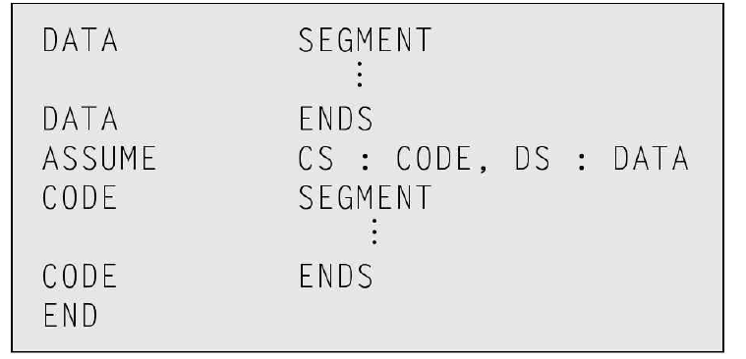
Assembler Directives(Pseudo Opcodes)
DUP: Used to initialize several locations and to assign values to location
Eg:RES DW 2 DUP(0)
END – End the Program –
ENDP – it is used to end the procedure . Eg :
ENDS – Marks the end of a logical segment.

Slide 46
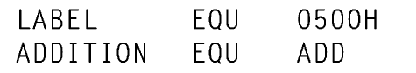
Assembler Directives(Pseudo Opcodes)
EQU – EQUATE - Used to assign label with a value or symbol. It is used to reduce the recurrence of values or constants in a program.
EVEN – Align On Even Memory Address - Tells the assembler to increment the location counter to the next even address if it is not already at an even address.

Slide 47
Assembler Directives(Pseudo Opcodes)

Slide 48
Assembler Directives(Pseudo Opcodes)

Slide 49
Assembler Directives(Pseudo Opcodes)
GROUP – Group related segment - Used to tell the assembler to group the logical segments named after the directive into one logical segment. This allows the content of all the segments to be accessed from the same segment base.

Slide 50
Assembler Directives(Pseudo Opcodes)
LENGTH - Used to determine the number of items in some data such as string or array. This directive is not available in MASM.
Names point out the functions of different modules and hence help in the documentation.
ORG – Originate - Tells the assembler to set the location counter value.
Example, ORG 7000H sets the location counter value to point to 7000H location in memory.

Slide 51
Assembler Directives(Pseudo Opcodes)
PROC- Used to mark the start of a named procedure.
MACRO- Used to identify the start of a Macro.
ENDM : Indicates the end of MACRO
LABEL - Used to give the name to the current value in the location counter.
SEGMENT- Used to indicate the start of a logical segment.
E.g.: CODE SEGMENT indicates to the assembler the start of a logical segment called CODE

Slide 52
Assembler Directives(Pseudo Opcodes)

Slide 53
Assembler Directives(Pseudo Opcodes)
Byte PTR: Used as a memory pointer for 8-bit data
Word PTR: Used as a memory pointer for 16-bit data

Slide 54
Assembler Directives(Pseudo Opcodes)

Slide 55
Procedures
Procedure: We can define a procedure as a named block of statements that ends in a return statement.
A procedure is declared using the PROC and ENDP directives.
It must be assigned a name (a valid identifier).
A procedure must be written in the end of the code segment (before end directive), and it can't receive any parameter

Slide 56
Procedures
The syntax is:
procedurename PROC
.
.
ret
procedurename ENDP
Call procedurename
SumOf PROC
add ax,bx
add ax,cx
ret
SumOf ENDP
Call SumOf

Slide 57
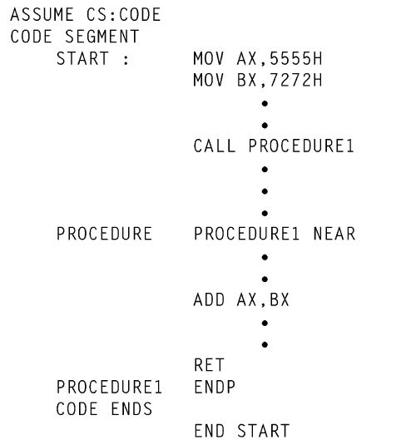
Eg:2 for Procedure

Slide 58
Macros
A Macro is a named block of assembly language statements.
Once defined, it can be invoked as many times in a program as you wish.
When you invoke a macro, a copy of its code is inserted directly into the program at the location where it was invoked.
This type of automatic code insertion is also known as inline expansion.
It is customary to refer to calling a macro, although technically there is no CALL instruction involved.
Defining Macros: A macro is defined using the MACRO and ENDM directives.

Slide 59
Macros

Slide 60
Macros

Slide 61
Macros
The syntax is:
macroname MACRO parameter-1, parameter-2…
statement-list
. . . ENDM
The syntax for calling a macro is:
macroname argument-1, argument-2, ...
Ex:
Ch DB ‘E’
Putchar MACRO char
mov dl, char
mov ah,02h
int 21h
ENDM
Putchar ch; calling a macro

Slide 62
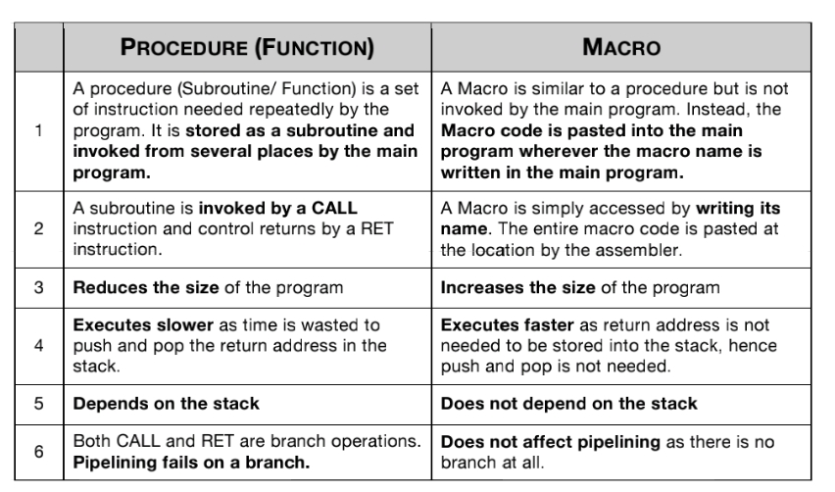
Difference Between Macro and Procedure

Slide 63
ALP TO EVALUATE ARITHMETIC EXPRESSION
ASSUME CS:CODE,DS:DATA,ES:EXTRA
DATA SEGMENT
A DW 0005H
B DW 0004H
C DW 0003H
X DW 0001H
DATA ENDS
EXTRA SEGMENT
RESULT DW ?
EXTRA ENDS
CODE SEGMENT
START:MOV AX,DATA
MOV DS,AX
MOV AX,EXTRA
MOV ES,AX

Slide 64
ALP TO EVALUATE ARITHMETIC EXPRESSION
MOV AX,X
MUL AX ; X*X
MOV BX,A
MUL BX ; A*X*X
MOV BX,AX ;A*X*X
MOV AX,X
MOV CX,B
MUL CX
ADD AX,BX
ADD AX,C
MOV RESULT,AX
CODE ENDS
END START
END

Slide 65
ALP TO FIND THE HIGHEST IN SERIES OF NUMBERS
Series of 100 numbers from [42000h] location. DS:4000 SI:2000
(100)d->0064h
Store the count in CX register.
Program
ASSUME CS:CODE,DS:DATA
CODE SEGMENT
START: MOV AX,4000H
MOV DS,AX
MOV SI,2000H
MOV CX,0064H
MOV AL,00H
BACK: CMP AL,[SI]
JNC SKIP
MOV AL,[SI]
SKIP:INC SI
LOOP BACK

Slide 66
ALP TO FIND THE HIGHEST IN SERIES OF NUMBERS
MOV [SI],AL;MOVE THE HIGHEST NUMBER FROM AL TO [SI]
INT 03H
CODE ENDS
END START
END

Slide 67
Find EVEN OR ODD IN A SERIES OF NUMBERS
Series of 100 numbers from [42000h] location. DS:4000 SI:2000
(100)d->0064h
Store the count in CX register.
ASSUME CS:CODE,DS:DATA
CODE SEGMENT
START: MOV AX,4000H
MOV DS,AX
MOV SI,2000H
MOV CX,0064H
Mov BL,00H;even count
Mov BH,00H;even count

Slide 68
Find EVEN OR ODD IN A SERIES OF NUMBERS
BACK: MOV AL,[SI]
ROR AL,1
JC ODD
INC BL
JMP NEXT
ODD:INC BH
NEXT:INC SI
LOOP BACK
MOV [SI],BX
INT 03H
CODE ENDS
END START
END

Slide 69
Find no. of Positive, Negative And zeroes in a series
Series of 100 numbers from [42000h] location. DS:4000 SI:2000
(100)d->0064h
Store the count in CX register.
ASSUME CS:CODE,DS:DATA
CODE SEGMENT
CODE SEGMENT
START: MOV AX,4000H
MOV DS,AX
MOV SI,2000H
MOV CX,0064H
Mov BL,00H;POSITIVE count
Mov BH,00H;NEGATIVE count
Mov DL,00H;ZERO count

Slide 70
Find no. of Positive, Negative And zeroes in a series
BACK:MOV AL,[SI]
ADD AL,00H
JZ ZERO
ROL AL,01H
JC NEGATIVE
INC BL
JMP SKIP
NEGATIVE:INC BH
JMP SKIP
ZERO:INC DL
SKIP:INC SI
LOOP BACK

Slide 71
DETERMINING WHETHER A STRING IS A PALINDROME
This program is a combination of string reversal and String comparison.
ASSUME CS:CODE,DS:DATA,ES:EXTRA
DATA SEGMENT
STRING1 DB ‘NITIN’
PAL DB 00H
DATA ENDS
EXTRA SEGMENT
STRING2 DB 05H DUP(?)
EXTRA ENDS
CODE SEGMENT
START: MOV AX,DATA
MOV DS,AX
MOV AX,EXTRA
MOV ES,AX

Slide 72
DETERMINING WHETHER A STRING IS A PALINDROME
LEA SI,STRING1
LEA DI,STRING2+04H
MOV CX,0005H
BACK: CLD
LODSB
STD
STOSB
LOOP BACK
LEA SI,STRING1
LEA DI,STRING2
MOV CX,0007
CLD
REPE CMPSB

Slide 73
DETERMINING WHETHER A STRING IS A PALINDROME
JNZ SKIP
INC PAL; IT’S A PALINDROME
SKIP:INT 03H
CODE ENDS
END START
END

